Slide 1
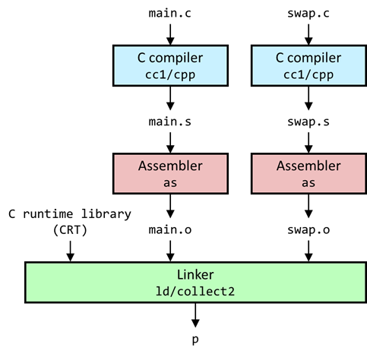
The Runtime Environment Life Cycle of a Program

Slide 2
The Runtime Environment
Part I: Life Cycle of a Program, Overview
Part II: Linking and Loading
Part III: Libraries

Slide 3
Lecture Overview
Part I – Life Cycle of a Program
Life Cycle of a Program
Linking Overview
Executable and Linkable Format
Summary

Slide 4
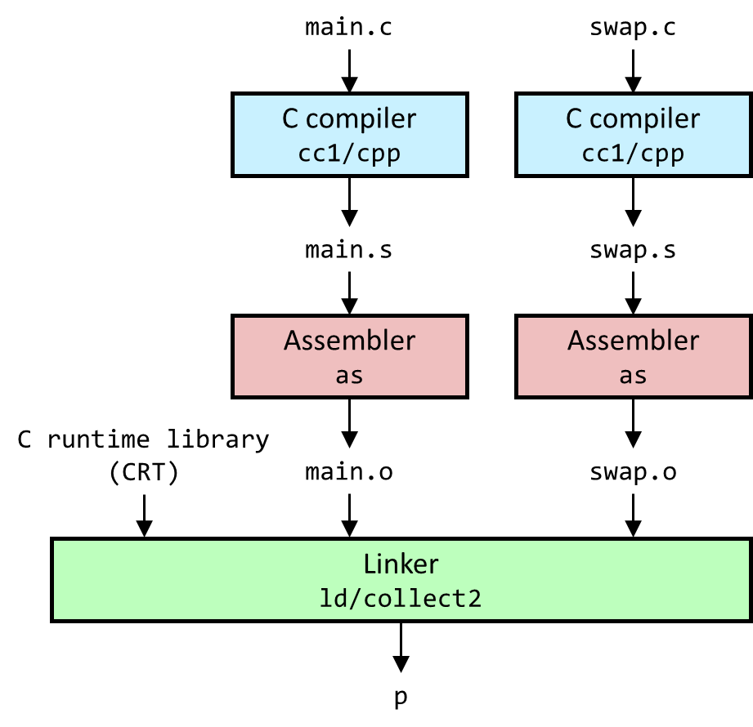
Life Cycle of a Program

Slide 5
A Simple C Program
extern int buf[];
int *bufp0 = &buf[0];
static int *bufp1;
void swap() {
int temp;
bufp1 = &buf[1];
temp = *bufp0;
*bufp0 = *bufp1;
*bufp1 = temp;
}
int buf[2] = {1, 2};
int main() {
printf("[ %d, %d ]\n", buf[0],buf[1]);
swap();
printf("[ %d, %d ]\n", buf[0],buf[1]);
return EXIT_SUCCESS;
}
main.c
swap.c
Compile to executable program with GCC
$ gcc -O2 -Wall -g -o p main.c swap.c main.c: In function ‘main’: main.c:9:3: warning: implicit declaration of function ‘swap’ [-Wimplicit-function-declaration] 9 | swap(); | ^~~~ $ ./p [ 1, 2 ] [ 2, 1 ] $

Slide 6
A Simple C Program
extern int buf[];
int *bufp0 = &buf[0];
static int *bufp1;
void swap() {
int temp;
bufp1 = &buf[1];
temp = *bufp0;
*bufp0 = *bufp1;
*bufp1 = temp;
}
int buf[2] = {1, 2};
int main() {
printf(…); swap();
printf(…);
}
main.c
GCC is, in fact, a compiler driver
Executes a series of commands that transform the source code into an executable
swap.c
$ gcc -v -O2 -Wall -g -o p main.c swap.c Using built-in specs. COLLECT_GCC=gcc COLLECT_LTO_WRAPPER=/usr/libexec/gcc/x86_64-pc-linux-gnu/12/lto-wrapper Target: x86_64-pc-linux-gnu Configured with: /var/tmp/portage/sys-devel/gcc-12.3.1_p20230526/work/gcc-12-20230526/configure --host=x86_64-pc-linux-gnu --build=x86_64-pc-linux-gnu --prefix=/usr --bindir=/usr/x86_64-pc-linux-gnu/gcc-bin/12 --includedir=… Thread model: posix …

Slide 7
A Simple C Program
int buf[2] = {1, 2};
int main() {
printf(…); swap(); printf(…);
return 0;
}
extern int buf[];
int *bufp0 = &buf[0];
static int *bufp1;
void swap() {
int temp;
bufp1 = &buf[1];
temp = *bufp0;
*bufp0 = *bufp1;
*bufp1 = temp;
}
Making sense of GCC’s compilation steps
main.c
$ ( gcc -v -O2 -Wall -g -o p main.c swap.c 2>&1 ) | \ grep "^ /usr/lib" | grep -v include | \ grep -E "^ /usr[^ ]*" /usr/libexec/gcc/x86_64-pc-linux-gnu/12/cc1 -quiet -v main.c -quiet -dumpdir p- -dumpbase main.c -dumpbase-ext .c -mtune=generic -march=x86-64 -g -O2 -Wall -version -o /tmp/ccsVkorq.s /usr/lib/gcc/x86_64-pc-linux-gnu/12/../../../../x86_64-pc-linux-gnu/bin/as -v --gdwarf-5 --64 -o /tmp/cc6XHLwD.o /tmp/ccsVkorq.s /usr/libexec/gcc/x86_64-pc-linux-gnu/12/cc1 -quiet -v swap.c -quiet -dumpdir p- -dumpbase swap.c -dumpbase-ext .c -mtune=generic -march=x86-64 -g -O2 -Wall -version -o /tmp/ccsVkorq.s /usr/lib/gcc/x86_64-pc-linux-gnu/12/../../../../x86_64-pc-linux-gnu/bin/as -v --gdwarf-5 --64 -o /tmp/cccb7yzI.o /tmp/ccsVkorq.s /usr/libexec/gcc/x86_64-pc-linux-gnu/12/collect2 -plugin /usr/libexec/gcc/x86_64-pc-linux-gnu/12/liblto_plugin.so -plugin-opt=/usr/libexec/gcc/x86_64-pc-linux-gnu/12/lto-wrapper -plugin-opt=-fresolution=/tmp/ccn23YHr.res -plugin-opt=-pass-through=-lgcc -plugin-opt=-pass-through=-lgcc_s -plugin-opt=-pass-through=-lc -plugin-opt=-pass-through=-lgcc -plugin-opt=-pass-through=-lgcc_s --eh-frame-hdr -m elf_x86_64 -dynamic-linker /lib64/ld-linux-x86-64.so.2 -pie -o p /usr/lib/gcc/x86_64-pc-linux-gnu/12/../../../../lib64/Scrt1.o /usr/lib/gcc/x86_64-pc-linux-gnu/12/../../../../lib64/crti.o /usr/lib/gcc/x86_64-pc-linux-gnu/12/crtbeginS.o -L/usr/lib/gcc/x86_64-pc-linux-gnu/12 -L/usr/lib/gcc/x86_64-pc-linux-gnu/12/../../../../lib64 -L/lib/../lib64 -L/usr/lib/../lib64 -L/usr/lib/gcc/x86_64-pc-linux-gnu/12/../../../../x86_64-pc-linux-gnu/lib -L/usr/lib/gcc/x86_64-pc-linux-gnu/12/../../.. /tmp/cc6XHLwD.o /tmp/cccb7yzI.o -lgcc --push-state --as-needed -lgcc_s --pop-state -lc -lgcc --push-state --as-needed -lgcc_s --pop-state /usr/lib/gcc/x86_64-pc-linux-gnu/12/crtendS.o /usr/lib/gcc/x86_64-pc-linux-gnu/12/../../../../lib64/crtn.o
swap.c

Slide 8
A Simple C Program
main.c
swap.c
Source files
C compiler
cc1/cpp
C compiler
cc1/cpp
main.s
swap.s
Separately compiled
assembly files
Assembler
as
Assembler
as
C runtime library
(CRT)
Separately assembled
relocatable object files
main.o
swap.o
Linker ld/collect2
Fully linked executable object file
p

Slide 9
From Source Code to a Running Process
stdlib.h util.h
mylib.h
stdlib.h
dynllib.h
main.c
util.c
process prog
CRT
libc.so
mylib.a
Kernel virtual memory
Translators
(cpp,cc1,as)
Translators
(cpp,cc1,as)
User stack
(created at runtime)
main.o
util.o
Memory-mapped region for
shared libraries
Linker (ld/collect2)
dynllib.so
(dynamically loaded by process)
Run-time heap
(created by malloc)
prog
Read/write segment (.data,.bss)
Read-only segment (.init,.text,.rodata)
Loader (execve)
libc.so
Unused
Dynamic linker (ld-linux.so)

Slide 10
Problems to Solve
Separate compilation of individual C files
how does the compiler know about functions and variables defined in other files to make sure the type matches?
how can we generate addresses to call functions / access variables if we do not know where they are located in memory?
how does the system know which dynamic libraries to load when executing a binary?
how does the application know how to call functions from dynamic libraries?

Slide 11
Linking Overview
$ gcc –c main.c $ readelf –s main.o …
Num: Size Type Bind Ndx Name
9: 8 OBJECT GLOBAL 3 buf
10: 83 FUNC GLOBAL 1 main
13: 0 NOTYPE GLOBAL UND swap

Slide 12
Why Linkers (Why Separate Compilation)?
Reason 1: Modularity
Program can be written as a collection of smaller source files, rather than one monolithic mass.
Can build libraries of common functions (more on this later)
e.g., Math library, standard C library

Slide 13
Why Linkers (Why Separate Compilation)? (cont)
Reason 2: Efficiency
Time: Separate compilation
Change one source file, compile, and then relink.
No need to recompile other source files.
Space: Libraries
Common functions can be aggregated into a single file...
yet executable files and running memory images contain only code for the functions they actually use.

Slide 14
What Do Linkers Do?
Step 1. Symbol resolution
Programs define and reference symbols (variables and functions):
void swap() {…} define symbol swap
swap(); reference symbol swap
int *bufp0 = &buf[0]; define symbol bufp0, reference buf
Symbol definitions are stored (by the compiler) in a symbol table.
Symbol table is an array of structs
Each entry includes name, size, and location of symbol
Linker associates each symbol reference with exactly one symbol definition.
symbol resolution: associating each symbol reference with exactly one symbol definition

Slide 15
What Do Linkers Do? (cont)
Step 2. Relocation
Consists of two steps
1. Relocation sections & symbol definitions: merges all sections of the same type into a new aggregate section of the type and then assigns memory addresses (e.g., .data sections from input modules into .data section of the executable)
Linker assigns run-time memory addresses to each section/symbol
Each instruction/global variable has a unique run-time memory address.
2. Relocating symbol references within sections: updates all references to these symbols to reflect their new positions via relocation entries (= the instructions on how to modify the reference)

Slide 16
Executable and Linkable Format (ELF)
ELF header
Segment header table
(required for executables)
.text section
.rodata section
.data section
.bss section
.symtab section
.rel.txt section
.rel.data section
.debug/.line section
Section header table

Slide 17
Three Kinds of Object Files (Modules)
Relocatable object file (.o file)
Contains code and data in a form that can be combined with other relocatable object files to form executable object file.
Each .o file is produced from exactly one source (.c) file
Executable object file (a.out file)
Contains code and data in a form that can be copied directly into memory and then executed.
Shared object file (.so file)
Special type of relocatable object file that can be loaded into memory and linked dynamically, at either load time or run-time.
Called Dynamic Link Libraries (DLLs) by Windows

Slide 18
Executable and Linkable Format (ELF)
Standard binary format for object files
Originally proposed by AT&T System V Unix
Later adopted by BSD Unix variants and Linux
One unified format for
Relocatable object files (.o),
Executable object files (a.out)
Shared object files (.so)
Generic name: ELF binaries

Slide 19
ELF Object File Format
ELF header
Word size, byte ordering, file type (.o, exec, .so), machine type, etc.
Segment header table
Page size, virtual addresses memory segments (sections), segment sizes.
.text section
Code
.rodata section
Read only data: string constants, jump tables, ...
.data section
Initialized global variables
.bss section
Uninitialized global variables
Or global variables initialized to 0
Stands for “Block Started by Symbol”
Has section header but occupies no space
0
ELF header
Segment header table
(required for executables)
.text section
.rodata section
.data section
.bss section
.symtab section
.rel.txt section
.rel.data section
.debug/.line section
Section header table

Slide 20
ELF Object File Format (cont.)
.symtab section
Symbol table (created even without –g option)
Procedure and static variable names
Section names and locations
.rel.text section
Relocation info for .text section
Addresses of instructions that will need to be modified in the executable
Instructions for modifying.
.rel.data section
Relocation info for .data section
Addresses of pointer data that will need to be modified in the merged executable
.debug/.line section
Info for symbolic debugging (gcc -g)
Section header table
Offsets and sizes of each section
0
ELF header
Segment header table
(required for executables)
.text section
.rodata section
.data section
.bss section
.symtab section
.rel.txt section
.rel.data section
.debug/.line section
Section header table

Slide 21
Analyzing ELF Files with Readelf
$ gcc -O2 -c linking.c (gcc 12.3.1)
$ readelf -a linking.o
ELF Header:
Magic: 7f 45 4c 46 02 01 01 00 00 00 00 00 00 00 00 00
Class: ELF64
Data: 2's complement, little endian
Version: 1 (current)
OS/ABI: UNIX - System V
ABI Version: 0
Type: REL (Relocatable file)
Machine: Advanced Micro Devices X86-64
…
Section Headers:
[Nr] Name Type Address Offset
Size EntSize Flags Link Info Align
[ 0] NULL 0000000000000000 00000000
0000000000000000 0000000000000000 0 0 0
[ 1] .text PROGBITS 0000000000000000 00000040
0000000000000000 0000000000000000 AX 0 0 1
…
Relocation section '.rela.text.startup' at offset 0x240 contains 9 entries:
Offset Info Type Sym. Value Sym. Name + Addend
000000000002 000200000002 R_X86_64_PC32 0000000000000000 .bss - 8
…
00000000004e 000800000002 R_X86_64_PC32 0000000000000000 chksum - 4
…
Symbol table '.symtab' contains 9 entries:
Num: Value Size Type Bind Vis Ndx Name
…
4: 0000000000000000 4 OBJECT LOCAL DEFAULT 3 i
5: 0000000000000000 83 FUNC GLOBAL DEFAULT 4 main
6: 0000000000000000 0 NOTYPE GLOBAL DEFAULT UND foo
7: 0000000000000000 4 OBJECT GLOBAL DEFAULT 2 counter
8: 0000000000000000 0 NOTYPE GLOBAL DEFAULT UND chksum
…
readelf -a: print all information -s: print symbol table -S: print section headers -r: print relocation info

Slide 22
Analyzing ELF Files with Readelf
$ gcc -O2 -c linking.c (gcc 12.3.1)
$ readelf -Ss linking.o
There are 14 section headers, starting at offset 0x3b0:
Section Headers:
[Nr] Name Type Address Offset
Size EntSize Flags Link Info Align
…
[ 1] .text PROGBITS 0000000000000000 00000040
0000000000000000 0000000000000000 AX 0 0 1
[ 2] .data PROGBITS 0000000000000000 00000040
0000000000000004 0000000000000000 WA 0 0 4
[ 3] .bss NOBITS 0000000000000000 00000044
0000000000000004 0000000000000000 WA 0 0 4
[ 4] .text.startup PROGBITS 0000000000000000 00000050
0000000000000053 0000000000000000 AX 0 0 16
…
[11] .symtab SYMTAB 0000000000000000 00000140
00000000000000d8 0000000000000018 12 5 8
[12] .strtab STRTAB 0000000000000000 00000218
0000000000000025 0000000000000000 0 0 1
…
Symbol table '.symtab' contains 9 entries:
Num: Value Size Type Bind Vis Ndx Name
0: 0000000000000000 0 NOTYPE LOCAL DEFAULT UND
1: 0000000000000000 0 FILE LOCAL DEFAULT ABS linking.c
2: 0000000000000000 0 SECTION LOCAL DEFAULT 3 .bss
3: 0000000000000000 0 SECTION LOCAL DEFAULT 4 .text.startup
4: 0000000000000000 4 OBJECT LOCAL DEFAULT 3 i
5: 0000000000000000 83 FUNC GLOBAL DEFAULT 4 main
6: 0000000000000000 0 NOTYPE GLOBAL DEFAULT UND foo
7: 0000000000000000 4 OBJECT GLOBAL DEFAULT 2 counter
8: 0000000000000000 0 NOTYPE GLOBAL DEFAULT UND chksum
readelf -a: print all information -s: print symbol table -S: print section headers -r: print relocation info
UND: undefined (as in “we don’t know yet”)

Slide 23
Analyzing ELF Files with Readelf
$ gcc -c linking.c (gcc 10.3.0)
$ readelf -Ss linking.o
There are 13 section headers, starting at offset 0x460:
Section Headers:
[Nr] Name Type Address Offset
Size EntSize Flags Link Info Align
…
[ 1] .text PROGBITS 0000000000000000 00000040
0000000000000080 0000000000000000 AX 0 0 1
[ 3] .data PROGBITS 0000000000000000 000000c0
0000000000000004 0000000000000000 WA 0 0 4
[ 4] .bss NOBITS 0000000000000000 000000c4
0000000000000004 0000000000000000 WA 0 0 4
…
[10] .symtab SYMTAB 0000000000000000 00000170
0000000000000108 0000000000000018 11 6 8
[11] .strtab STRTAB 0000000000000000 00000278
000000000000003f 0000000000000000 0 0 1
…
Symbol table '.symtab' contains 11 entries:
Num: Value Size Type Bind Vis Ndx Name
0: 0000000000000000 0 NOTYPE LOCAL DEFAULT UND
1: 0000000000000000 0 FILE LOCAL DEFAULT ABS linking.c
2: 0000000000000000 0 SECTION LOCAL DEFAULT 1
3: 0000000000000000 0 SECTION LOCAL DEFAULT 4
4: 0000000000000000 4 OBJECT LOCAL DEFAULT 4 i
5: 0000000000000000 25 FUNC LOCAL DEFAULT 1 bar
6: 0000000000000000 4 OBJECT GLOBAL DEFAULT 3 counter
7: 0000000000000000 0 NOTYPE GLOBAL DEFAULT UND chksum
8: 0000000000000019 103 FUNC GLOBAL DEFAULT 1 main
9: 0000000000000000 0 NOTYPE GLOBAL DEFAULT UND _GLOBAL_OFFSET_TABLE_
10: 0000000000000000 0 NOTYPE GLOBAL DEFAULT UND foo
readelf -a: print all information -s: print symbol table -S: print section headers -r: print relocation info
UND: undefined (as in “we don’t know yet”)

Slide 24
Summary
Summary
-------------
-------------
-------------
-------------
-------------
-----

Slide 25
Summary
Linking allows modularization
at compile time
at load-time
at run-time
Linking involves two main operations
symbol resolution: map a symbol reference to a unique symbol definition across the entire program
symbol relocation: merging the sections of the same type and updating the symbol references to the new locations
Executable and linkable format
common binary format of executables, libraries, and compiled object files
contains all necessary information to support static and dynamic linking and loading
very versatile and used on (almost) all platforms

